Slide 1
1.-Surge Capacity
2.- National Societie Preparedness

Slide 2
Analysis of surge deployments in the past 6 years

Slide 4
Notes:
Biological with 132 deployments, from which 76% are related to Ebola and 14% with Cholera
Human Related with 108 deployments, from which 55% are related to population movement, 25% with complex emergencies and 19% with famine.
Hydrological with 66 deployments, from which 94% are related to floods.

Slide 5
Notes:
43 % of all deployment are lniked to WatSan (24%) and Health (19%) specialities.
21% are related to Logistics (7%) Relief (7%) and Shelter (7%) specialities.
13% are General RDRTs, but it’s important to notice that the number of this kind of deployments in the past 3 years had drastically reduced, as now the request of support of the operations is more on the technical side.
7% are related to CEA (4%), PSS (1%), Livelihoods (1%) and CTP (1%) specialities. Its excepcted that the number of deployents of this specialities (with the expection of relief) is going to increase rapidly in the comming years.
7% are related to Support services as Fiannce, IM, ITT, PMER, Administration, Comms, HR. This numbers are reduced as usually these needs are covered by IFRC Staff and they were not properly recorded in the past. Also the IFRC doesnt have a proper capacity enhancemt trainings for this specialities, specially considering that all medium to big size operations have a great need of support services in order to function properly.

Slide 6
Notes:
52 % of the regional deplyments were cover with personel from 6 NS:
Ivory Coast (13%),
Benin (12%),
Togo (9%),
Cameroon (8%),
DRC (5%)
Guinea (5%)

Slide 7
Notes:
1/3 or the surge support has been mainly focused on DRC (22%) and Nigeria (10%)
4 RDRTs were deployed in 2017 as iter-regional support to the America RO (Haiti)

Slide 8
Assessment of the Africa Surge Roster

Slide 10
Reasons why the surge members that had never been deployed doesn’t apply more often to the alerts:
Notes:
41% of the reasons for not being deployed are beyond the control of the IFRC (red color) as 19% have to do with the lack of authorization of their NS for deployments, 15% related to their current jobs, which do not allow them to be deployed and 7% are no longer active members of their NS.
33% of the reasons can be mitigated through better training and follow-up (blue color) since 22% do not apply because they do not have the required specialty and 11% do not know the application procedure.
13% of the reasons are directly related to the lack of command of the language required in the field

Slide 11
Composition of the Africa Surge Roster

Slide 12
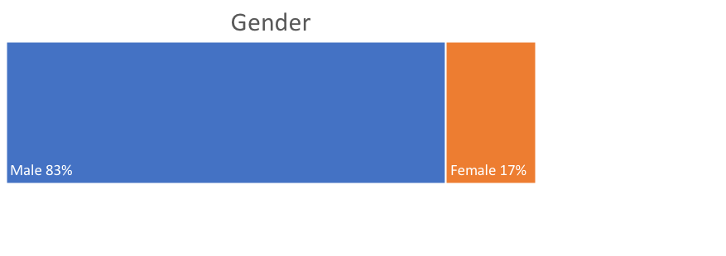

Slide 14
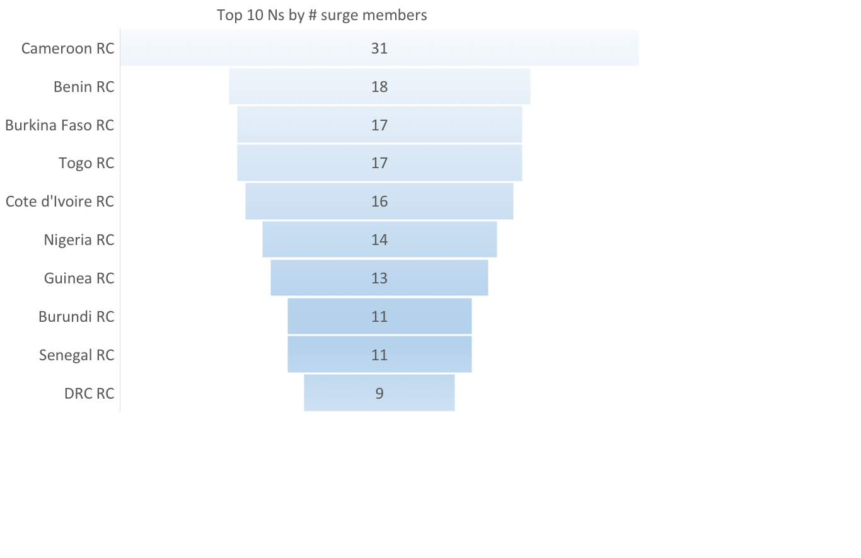

Slide 15
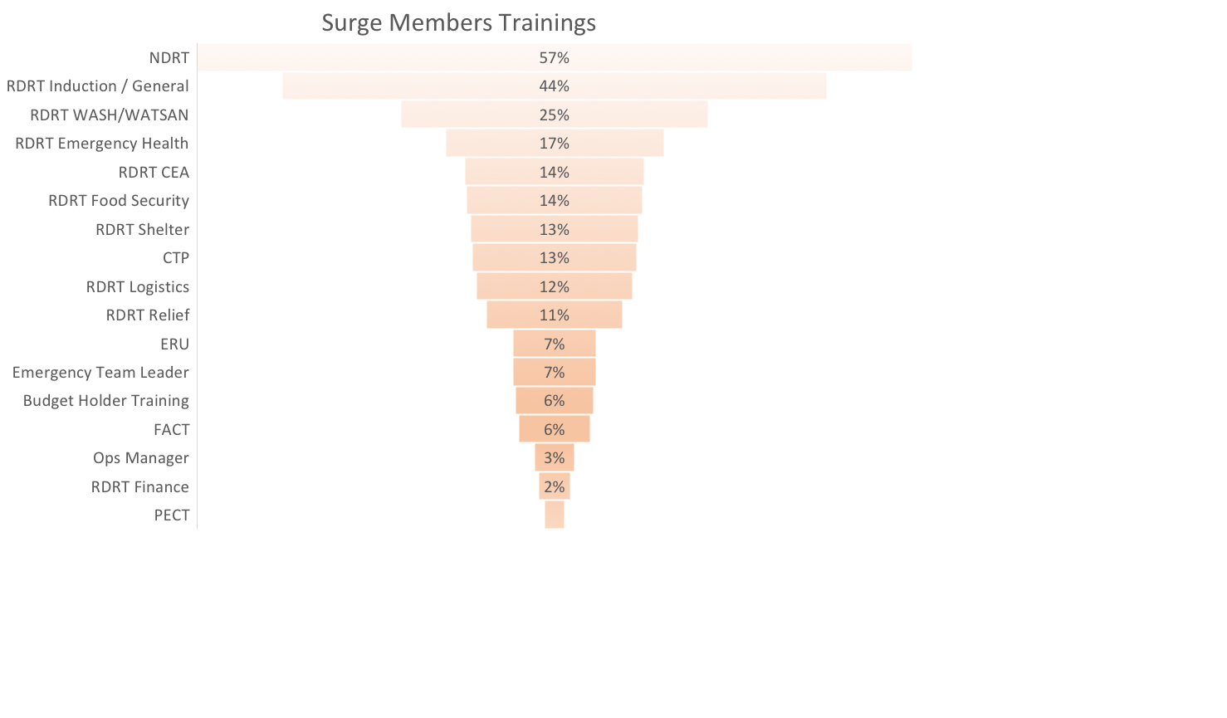

Slide 17
Surge Capacity as the Capacity-Building Process at Both National and Regional Levels

Slide 18
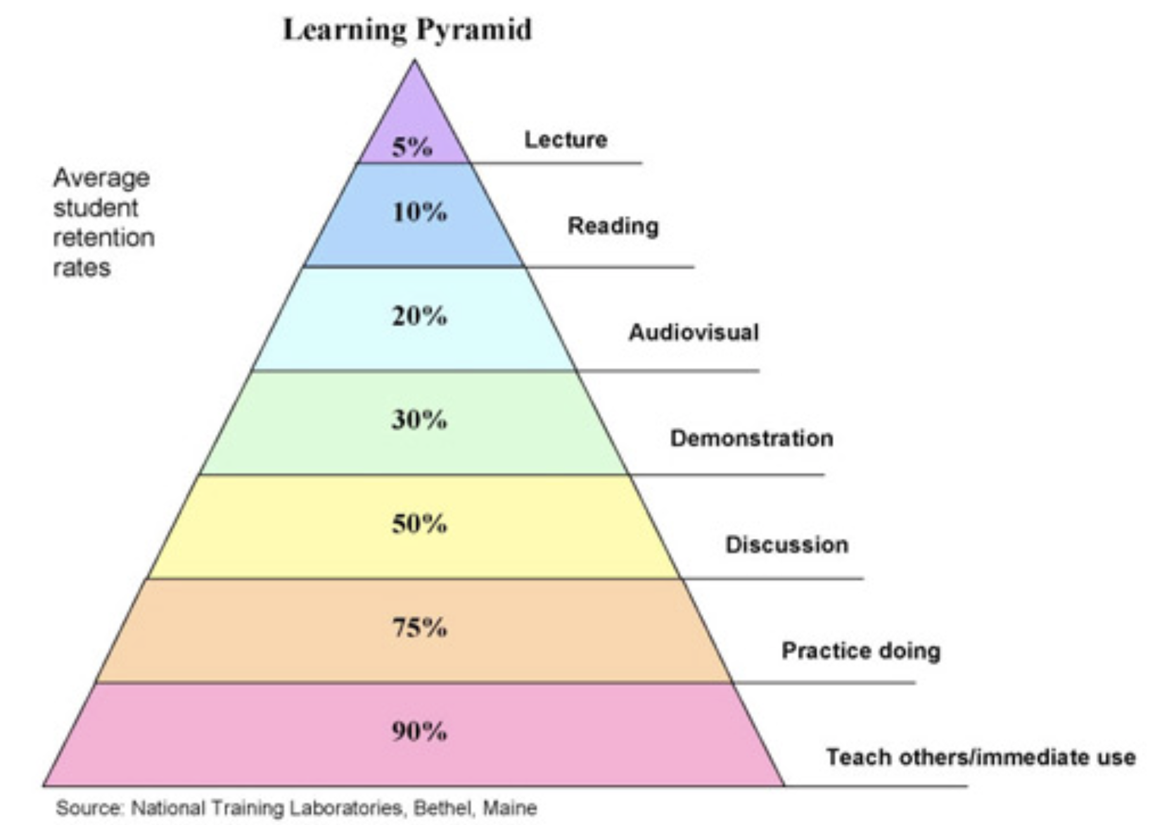
1. Trainings
Face to face
e-learning
Self-directed (asynchronous)
Instructor-led (synchronous)
2. Internships
3. Shadowing
4. Mentorships

Slide 19
Capacity-Building (names to be change shortly)
National Disaster Response Teams
Regional Disaster Response Teams
New
Developing Disaster Managers
Specialty Trainings

Slide 20
Tier 1
Tier 2
Tier 3
function effectively as part of a RC team.
Translates strategic decision into sectoral direction.
Operates at a strategic, multi-sectoral level in a response of any magnitude.
FACT
DHeOps
ETL
NDRT
RDRT
DDM
Ops Manager
Specialities

Slide 21
National Societie Preparedness
Preparedness for Efective Response (PER)

Slide 22
Where are we coming from?
2017 – CRC & IFRC Technical WG Common approach, revise ‘Mechanism Components to align WPNS and DRCE
2016 –IFRC WPNS Review, new process and tool
2013 – IFRC Principles and Rules for RCRC Humanitarian Assistance
2012 – IFRC 31 NDPRM Components
2015-2017 DRCE 4 Asia-Pacific NS
2013 – 2015 CRC CERA/SERA project. DRCE 5 Americas and 4 Africa NS
2008- 2010 – IFRC NDRPM: Guidelines for NS
2010-2012 CRC FRI project DRCE developed by CRC - IFRC – CREPD. 4 countries in America and 1 Asia .
2001 – 2012 IFRC - Well prepared National Societies (WPNS)
1999– IFRC DP& DM Policy
Notes:
NDPRM National Disaster Preparedness and Response Mechanism

Slide 23
Preparedness for Effective Response (PER)
Revised and updated common approach
Aligned with the Movement and external initiatives, based on our collective experience and learning (WPNS – DRCE)
Allows evidence-based analysis and planning for NS response capacity

Slide 24

WPNS+
Unified and Common RCRC Movement Approach for NS Response Capacity Enhancement (w/ updated components)

Slide 25
5 Areas
Policy, Strategy and Standards
Analysis and Planning
Operational Capacity
Coordination
Operations Support

Slide 26
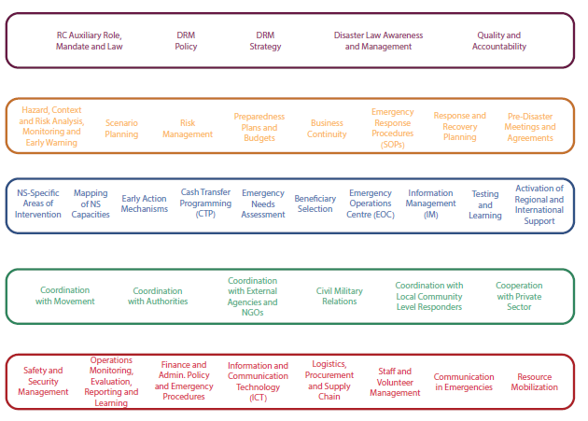
37 Components

Slide 27
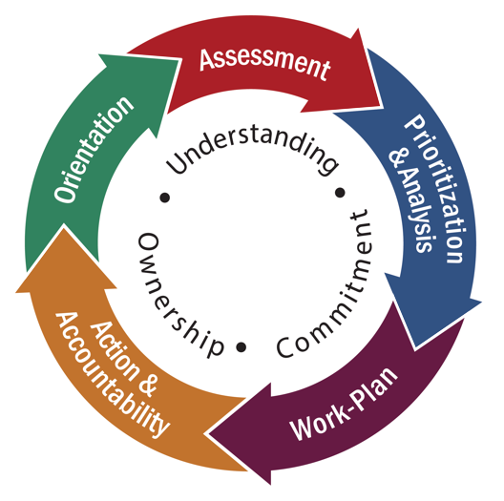
The Preparedness for Effective Response Process
The PER process consists of five equally important phases.

Slide 28




Self-Assessment
Simulation
Operational
Post-Operational
Facilitated self-assessment process
External assessment for response scenario
External assessment
External assessment
Low cost
High cost
Low-Med Cost
Low-Med Cost
PER: 1 or 2
NS: DM team, FPs, admin, management
PER: 6-12
NS: All response actors
PER: 3-8
NS: All response actors
PER: 2-6
NS: DM team, FPs, admin, management
- 1 month preparation
- 1 week in-country
- 2 months (minimum)
- 12 days in-country
- 1 week preparation
- in-country depends
- 2 weeks preparation
- 10 days in-country

Slide 29
Key points:
Updated RCRC approach: Preparedness for Effective Response
5 equally important phases: Orientation, Assessment, Prioritization & Analysis, Workplan, Action & Accountability
Based on our collective experience and learning over 2 decades
Evidence-based approach
Short to long-term investment
Looks to understand root-cause and barriers for NS to change
Prioritises different response components
Takes a cross-departmental perspective
Aligns with other RCRC Movement tools and approaches

